Slide 1

CONDITIONAL RANDOM FIELDS
Submitted by:-
Anirudha Mishra
B.Tech Biotechnology SecB (Sem 7)
A0504120108
BTB/20/243

Slide 2
INTRODUCTION
Conditional random fields (CRFs) are a class of statistical modeling methods often applied in pattern recognition and machine learning and used for structured prediction. Whereas a classifier predicts a label for a single sample without considering "neighbouring" samples, a CRF can take context into account. To do so, the predictions are modelled as a graphical model, which represents the presence of dependencies between the predictions. What kind of graph is used depends on the application.
examples where CRFs are used are: labeling or parsing of sequential data for natural language processing or biological sequences,[1] part-of-speech tagging, shallow parsing,[2] named entity recognition,[3] gene finding, peptide critical functional region finding,[4] and object recognition[5] and image segmentation in computer vision.

Slide 3
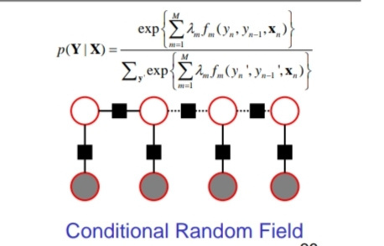
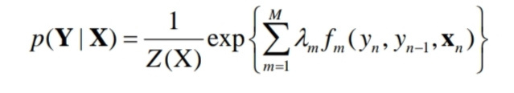
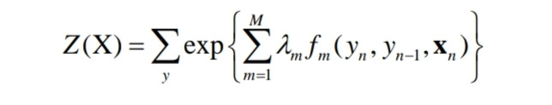
CRF DEFINITION
• A linear chain CRF is a distribution
p(Y|X) that takes the form
• Where Z(X) is an instance specific
normalization function

Slide 4
CHARACTERISTIC FEATURES
Conditional Modeling: CRFs focus on modeling the conditional distribution of the output labels given the input features. This is particularly useful for structured prediction tasks where the output is dependent on the input.
Graphical Representation: CRFs are often represented using graphical models, where nodes represent input features and output labels, and edges depict the dependencies between them. This graphical representation helps visualize the relationships between variables.
Label Dependencies: CRFs model complex dependencies between output labels by considering global interactions and correlations, making them well-suited for tasks where local decisions depend on the entire sequence or grid.

Slide 5
Features Integration: CRFs can incorporate various types of features, including local and global features, to capture relevant information from the input data and improve predictive accuracy.
Structured Learning: CRFs enable structured learning, allowing the model to be trained to optimize the overall sequence or grid accuracy, instead of just individual label predictions. This is crucial for maintaining coherence in the output.
Inference Algorithms: Efficient algorithms like the Viterbi algorithm or belief propagation are used for inference in CRFs. These algorithms find the most likely sequence of output labels given the input, facilitating real-time applications.
Label Transitions: CRFs can naturally capture label transition patterns, which are common in sequences. For example, in part-of-speech tagging, certain words are more likely to follow others, and CRFs can capture such patterns.

Slide 6
Structured Output: CRFs are well-suited for tasks with structured output, such as sequence labeling, image segmentation, and biological sequence analysis, where the output labels have a specific order or arrangement.
Interpretable Dependencies: The graphical representation of CRFs allows for visualizing and understanding the relationships and dependencies between different output labels and input features, enhancing interpretability.
Regularization: CRFs can naturally incorporate regularization terms to prevent overfitting and improve generalization, which is important when working with limited training data.

Slide 7
MATHEMATICAL OVERVIEW OF CRF
In CRFs, our input data is sequential, and we have to take previous context into account when making predictions on a data point. To model this behavior, we will use Feature Functions, that will have multiple input values, which are going to be:
The set of input vectors, X
The position i of the data point we are predicting
The label of data point i-1 in X
The label of data point i in X
We define the feature function as: f(X,i, fi-1, fi)
The purpose of the feature function is to express some kind of characteristic of the sequence that the data point represents.
For instance, if we are using CRFs for Parts-of-Speach tagging, than
f (X, i, L{i - 1}, L{i} ) = 1 if L{i - 1} is a Noun, and L{i} is a Verb. 0 otherwise.
Similarly, f (X, i, L{i - 1}, L{i} ) = 1 if L{i - 1} is a Verb and L{i} is an Adverb. 0 otherwise.

Slide 8
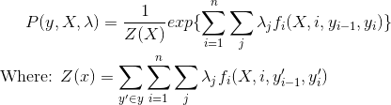
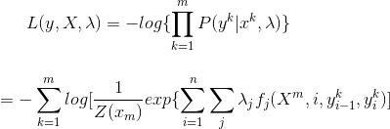
Each feature function is based on the label of the previous word and the current word, and is either a 0 or a 1. To build the conditional field, we next assign each feature function a set of weights (lambda values), which the algorithm is going to learn
To estimate the parameters (lambda), we will use Maximum Liklihood Estimation. To apply the technique, we will first take the Negative Log of the distribution, to make the partial derivative easier to calculate:

Slide 9
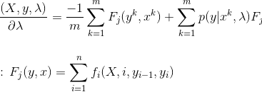
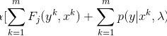
To apply Maximum Liklihood on the Negative Log function, we will take the argmin (because minimizing the negative will yield the maximum). To find the minimum, we can take the partial derivative with respect to lambda, and get:
We use the Partial Derivative as a step in Gradient Descent. Gradient Descent updates parameter values iteratively, with a small step, until the values converge. Our final Gradient Descent update equation for CRF is:

Slide 10
As a summary, we use Conditional Random Fields by first defining the feature functions needed, initializing the weights to random values, and then applying Gradient Descent iteratively until the parameter values (in this case, lambda) converge. We can see that CRFs are similar to Logistic Regression, since they use the Conditional Probability distribution, but we extend the algorithm by applying Feature functions as our sequential inputs.

Slide 11
How CRFs differ from Hidden Markov Models?
Hidden Markov Models are generative, and give output by modeling the joint probability distribution. On the other hand, Conditional Random Fields are discriminative, and model the conditional probability distribution. CRFs don’t rely on the independence assumption (that the labels are independent of each other), and avoid label bias. One way to look at it is that Hidden Markov Models are a very specific case of Conditional Random Fields, with constant transition probabilities used instead. HMMs are based on Naive Bayes, which we say can be derived from Logistic Regression, from which CRFs are derived.

Slide 12
ADVANTAGES
Structured Output:CRFs are suitable for structured prediction tasks where the output is a sequence or a grid, such as part-of-speech tagging, named entity recognition, and image segmentation.
Global dependencies: CRFs model global dependencies between output labels, considering the interactions between neighboring labels.
Feature Flexibility: CRFs can incorporate a wide range of features, both local and global, enabling them to capture complex patterns and relationships in the data.
Explicit Modeling: CRFs provide a clear framework for modeling the joint probability distribution of output labels, making the modeling process more interpretable and adaptable to specific task requirements.

Slide 13
Inference: Efficient inference algorithms like the Viterbi algorithm or belief propagation can be used to find the most likely sequence of labels given the input data, making CRFs suitable for real-time applications.
Structured Learning: CRFs allow for structured learning, which means the model can be trained to optimize for the entire sequence's or grid's accuracy, rather than just individual label predictions.
Semi-Supervised Learning: CRFs can incorporate unlabeled data during training through the use of both labeled and unlabeled examples, enhancing their ability to generalize to diverse data distributions.
Multi-Task Learning: CRFs can be extended to handle multiple related tasks simultaneously by sharing parameters or features across tasks, leading to improved performance and better generalization.
Effective Post-Processing: In tasks like optical character recognition and speech recognition, CRFs can be used to refine noisy outputs from other models by considering contextual information.
Interpretability: CRFs provide insights into how the model makes predictions by showing the relationships and dependencies between labels in the output sequence or grid.

Slide 14
DISADVANTAGE
Complexity: CRFs can become computationally intensive, especially when dealing with large-scale datasets or complex feature sets. Inference and training can require significant computational resources.
Feature Engineering: CRFs heavily rely on feature engineering to capture relevant patterns in the data. Designing effective features can be challenging and time-consuming, and the quality of features can greatly impact the model's performance.
Scalability: As the length of input sequences or grids increases, the complexity of CRFs can grow exponentially, making them less scalable for very long sequences or grids.
Label Bias: CRFs are prone to label bias, where the model assigns more weight to frequent labels, potentially leading to poor generalization for rare labels.

Slide 15
Global Dependencies: While modeling global dependencies is an advantage, it can also lead to increased complexity and potential overfitting, particularly when dealing with noisy or ambiguous data.
Limited Expressiveness: CRFs might struggle with capturing complex and non-linear relationships between features, as they primarily rely on linear combination of features.
Lack of Flexibility in Output: CRFs are most suitable for tasks with structured outputs.
Parameter Tuning: Selecting appropriate parameters for CRFs, such as regularization terms or smoothing parameters, can be a non-trivial process that requires domain expertise.
Interpretability Challenges: While CRFs provide insights into dependencies, understanding complex interactions between labels and features can still be challenging due to the model's complexity.
Data Annotation: Structured prediction tasks often require detailed and specific annotations, which can be more time-consuming and expensive to collect compared to simple classification tasks.

Slide 16
APPLICATION
Given their ability to model sequential data, CRFs are often used in Natural Language Processing, and have many applications in that area. One such application we discussed is Parts-of-Speech tagging. Parts of speech of a sentence rely on previous words, and by using feature functions that take advantage of this, we can use CRFs to learn how to distinguish which words of a sentence correspond to which POS. Another similar application is Named Entity recognition, or extracting Proper nouns from sentences. Conditional Random Fields can be used to predict any sequence in which multiple variables depend on each other. Other applications include parts-recognition in Images and gene prediction.

Slide 17
End Notes
Entities are parts of text that are of interest for the business problem at hand
Sequence of words or tokens matter in identifying entities
Pattern recognition approaches such as Regular Expressions or graph-based models such as Hidden Markov Model and Maximum Entropy Markov Model can help in identifying entities. However, Conditional Random Fields (CRF) is a popular and arguably a better candidate for entity recognition problems.
CRF is an undirected graph-based model that considered words that not only occur before the entity but also after it
The Python code provided helps in training a CRF model and extracting entities from text

Slide 19
THANK
YOU!

